Slide 1

The Cost Benefit Analysis of Obtaining Secondary Education
Group 5
Christine Kessler
Sarah Mwanzi
Maclean Asante
Jerin Black

Slide 2
Project Proposal
Focuses:
Highest starting median salaries & mid-career salaries
Top 30 Colleges
Private vs. Non-Private colleges
Top 10 Colleges of each
Earnings by major
Return on Investment (ROI) only based on tuition (4-years) and salary (20-years)
This topic intrigues us because we’re interested in understanding how higher education impacts our long term earnings potential.

Slide 3
Hypothesis
Going to a private university increases chances of earning a higher starting salary but may result in a lower ROI.

Slide 4
Questions:
What’s the best university to attend for a higher starting & mid-career salary?
Which private & non-private universities have the highest earning potential.
Would it be more beneficial to attend a private vs. a non-private university to earn more down the line?
What specific field/major gives you the best long-term earning potential?
Does a higher tuition cost guarantee a greater ROI?

Slide 5
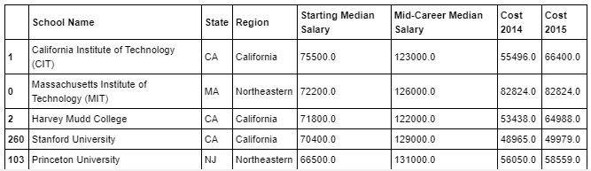
Process: Exploration & Cleanup
Exploration:
We searched major sites (e.g. Bureau of Labor Statistics, Kaggle, PayScale, etc.) to gather data related to higher education.
Sources that includes:
Entry-level median salary
Mid-career
Cost of tuition
Majors
Across the U.S.
We used an API key to pull the cloropleth map
*Sources are listed on slide 10
Data that is needed to satisfy the questions:
Empirical verifiable information from reliable sources
Kaggle & PayScale data to satisfy salary information
Collected data for university tuition (excluding room/board, financial aid, debt, books & fees)
Assumptions that the degree will only take 4 years to complete

Slide 6
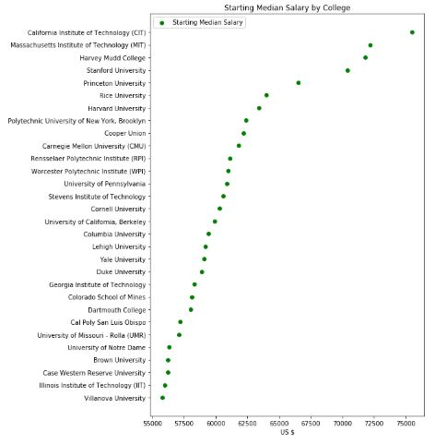
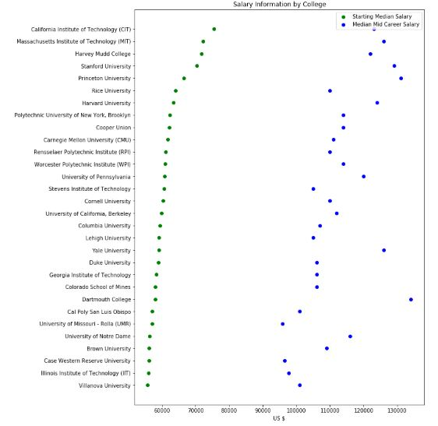
Process: Analysis
An overabundance of information, needed to narrow the scope down
University names and descriptions were not consistent across platforms
ROI can include many things. Narrowed it down to include only the cost of tuition & starting salary
Surprisingly, some data regarding cost and earnings was consistent across data sources

Slide 7
Findings
We found that starting median salaries for college graduates are around $46k and mid-career is about $84k. The average cost of college in 2015 was around $55k.
CIT had the highest starting salary of $75,500 with the cost of attendance being $58,755. Villanova being the lowest with a starting salary of $55,800 and the cost of tuition being $58,736.
We also found that there was a significant difference between the pay scale of the top ten and bottom ten majors in 2015. The earnings for the top 10 majors were $175k-125k. The range for the bottom 10 were $40k-50k. The highest earning undergraduate degree was Petroleum Engineering ($175k). The lowest was Early Childhood Education ($40k).
Lastly, just because you attend a college/university with a higher earning entry-level salary, doesn’t mean you’ll have a higher ROI in the long-run. This is also true for private universities.

Slide 8
Q&A

Slide 9
Sources of Data
Kaggle
https://Kaggle.com/WSJ/college-salaries#salaries-by-region.csv
Salaries by College
Degrees That Pay Back
PayScale
https://www.payscale.com/college-salary-report
Cost Pay Analysis
API
https://data.bls.gov/PDQWeb/LE
Google
Maps

